Slide 1
ME350 Manufacturing Review 1
Group 35 Yang Zhang, Wenyue Li, Jiarui Gu

Slide 2
Contents
Group Introduction
Overall Design
Linkage Design
Flashlight-to-coupler mounting Strategy
Joint Design
Playing Field Design
Engineering Drawings
Notes:
**The stands of the leftmost and rightmost photosensor are printed with a cone around the light receptor

Slide 3

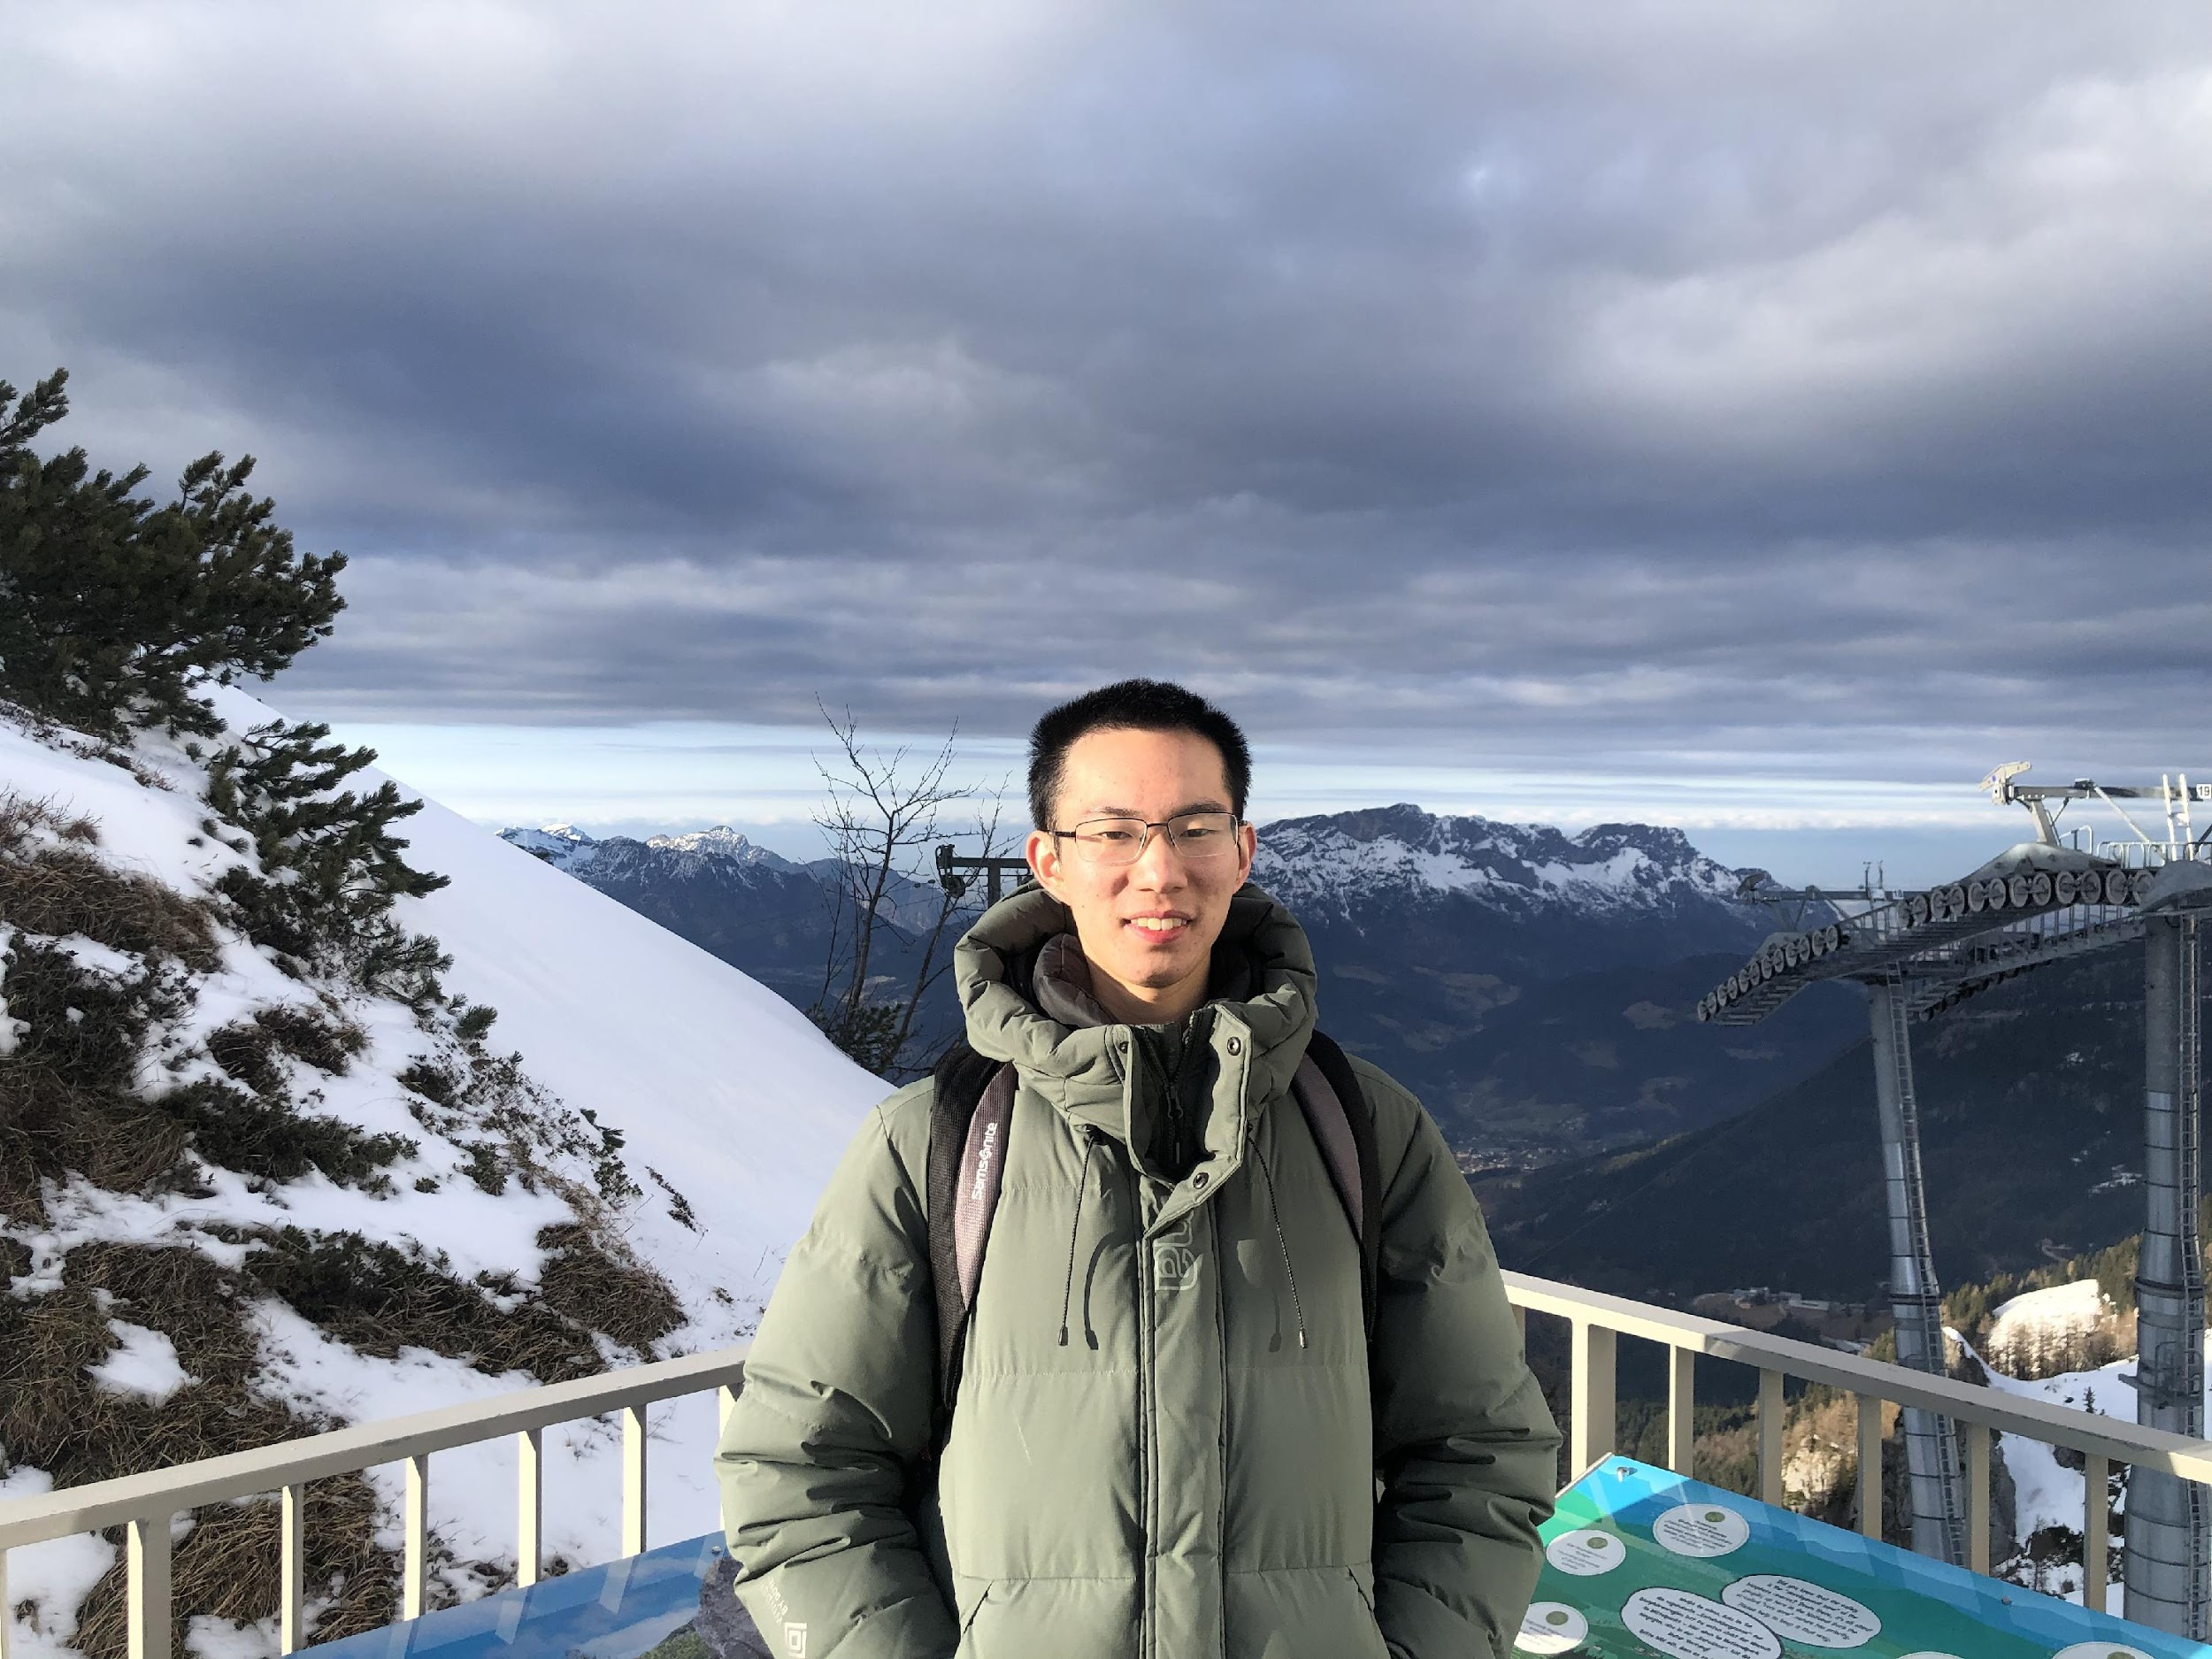

Group Introduction
Group 35
Group Leader
Group Member
Group Member
Yang Zhang
Jiarui Gu
Wenyue Li
Notes:
**The stands of the leftmost and rightmost photosensor are printed with a cone around the light receptor

Slide 4
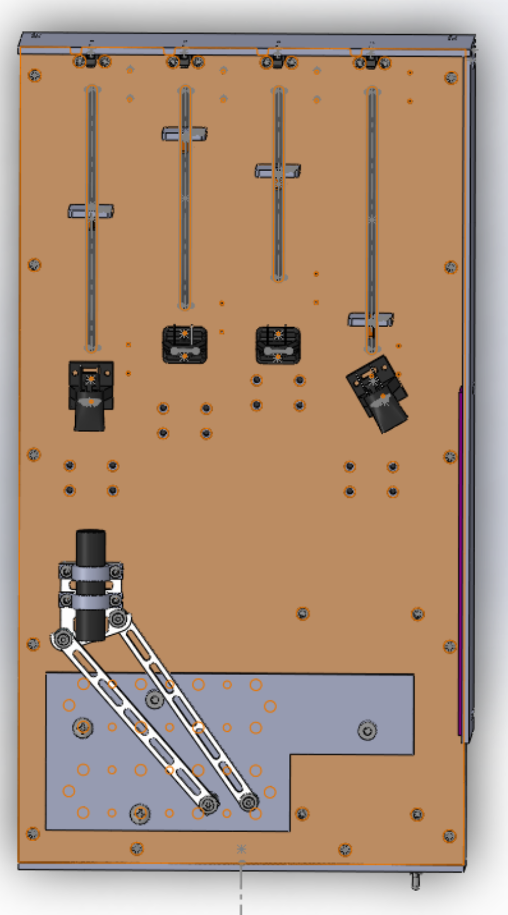
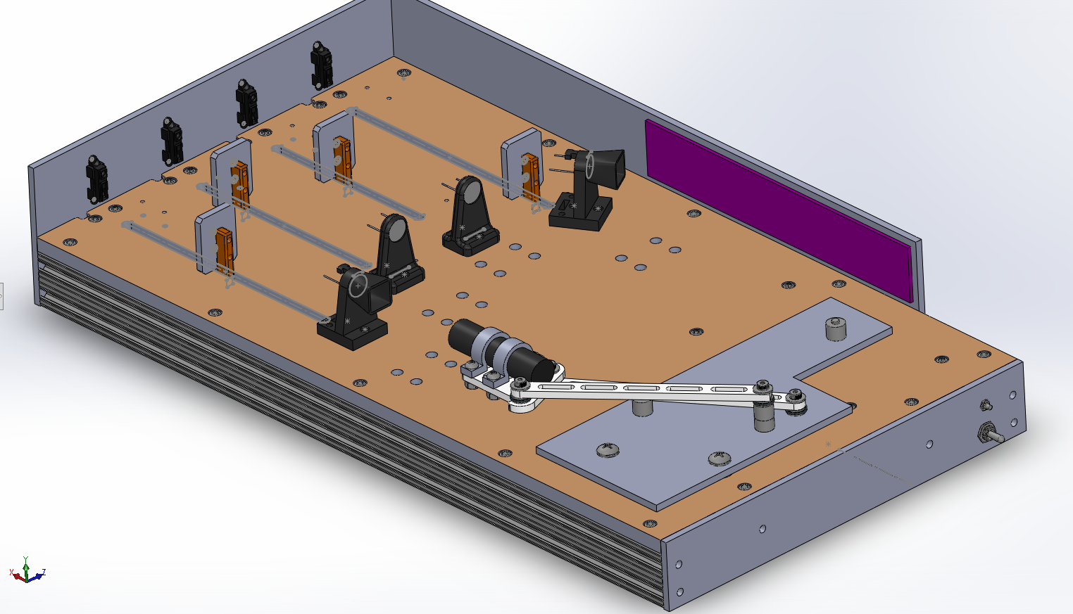
Overall Design
Baseplate
Follower
Input
Hard Stops
Notes:
**The stands of the leftmost and rightmost photosensor are printed with a cone around the light receptor

Slide 5
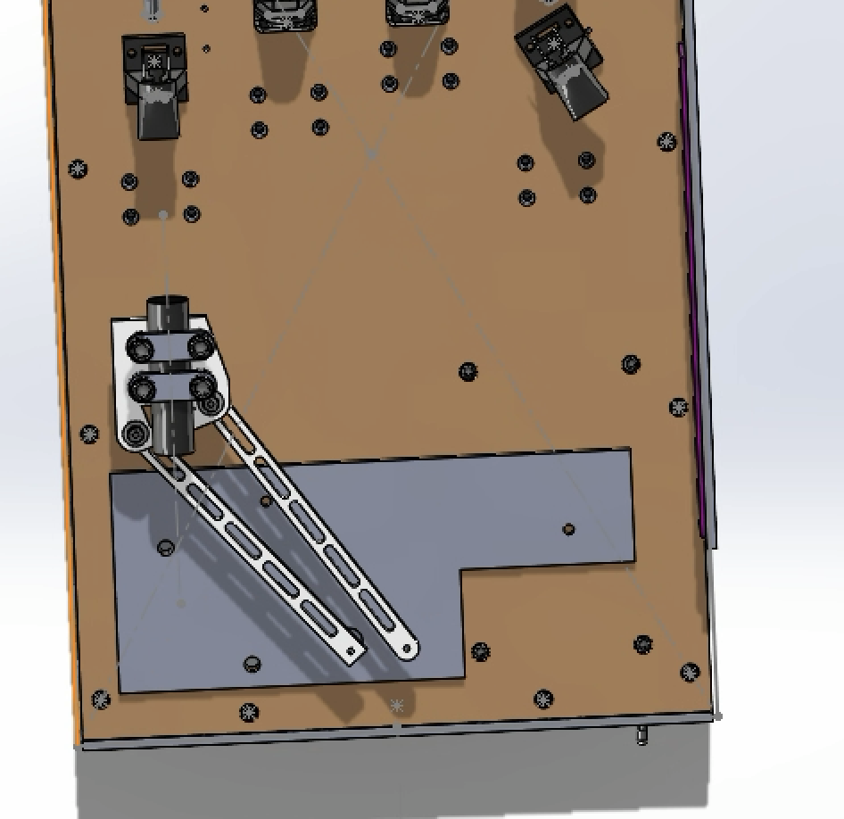
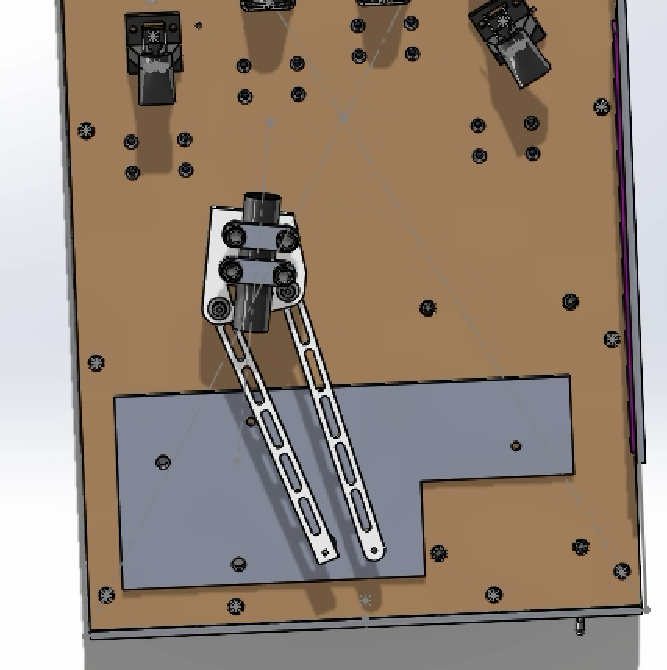
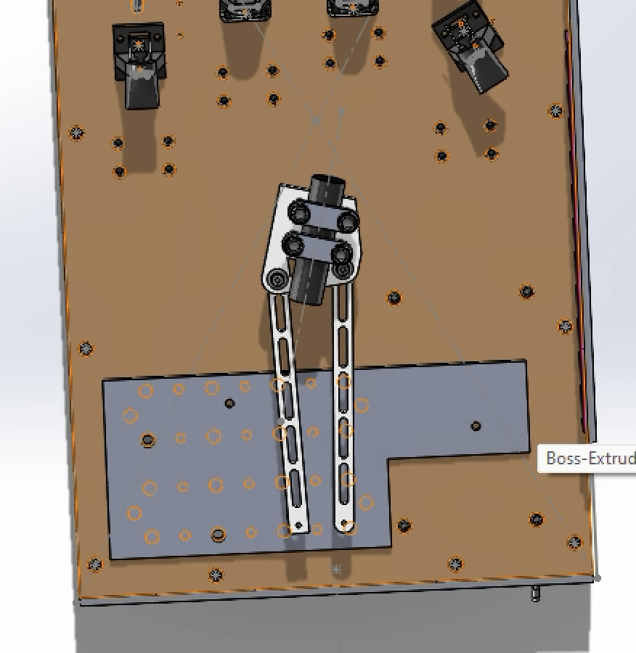
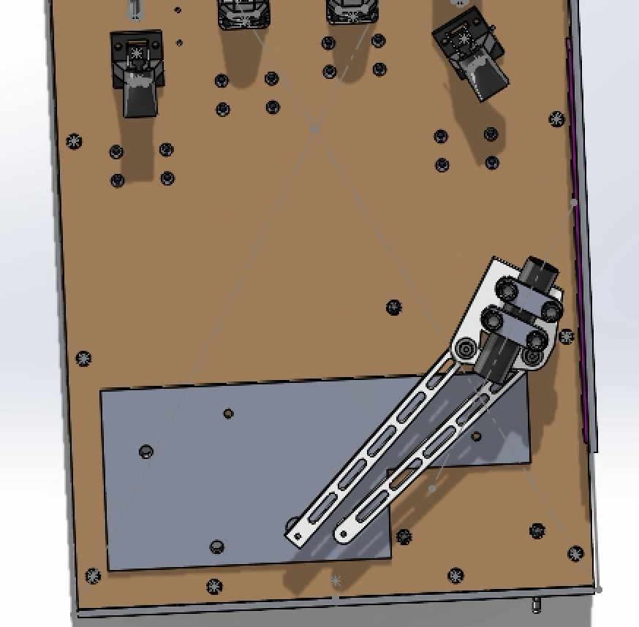
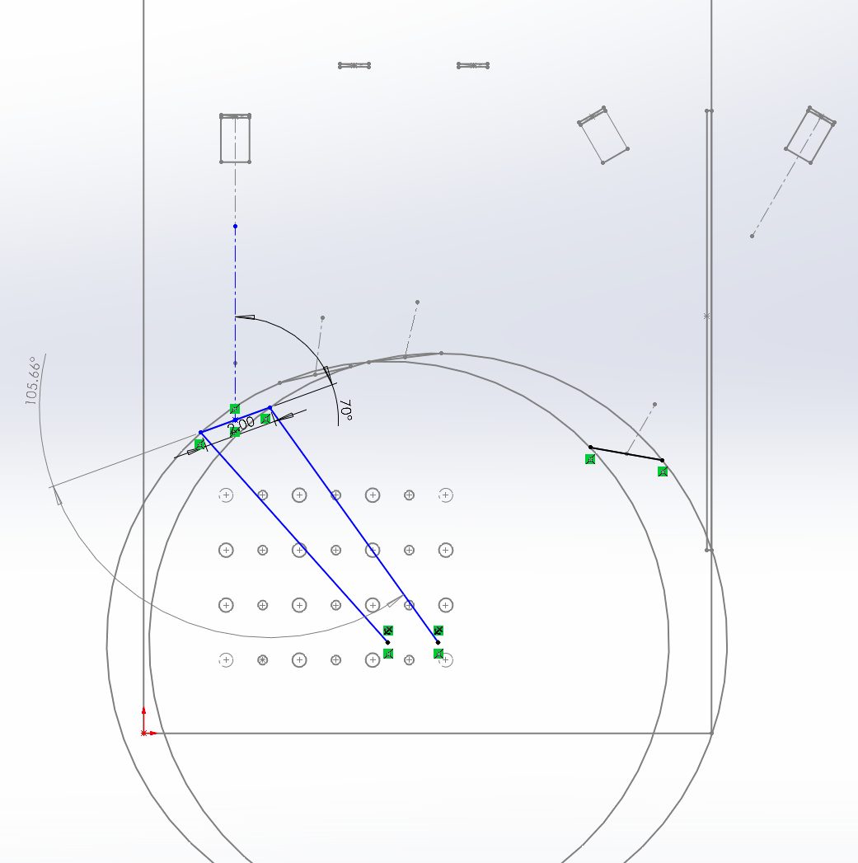
Linkage Design
Transmission Angle
Part | Input | Follower | Coupler
Length (inch) | 7.67 | 7.89 | 2.00
 | Target 1 | Target 2 | Target 3 | Target 4 | Average
Transmission Angle(deg) | 15.66 | 4.73 | 7.4 | 40.96 | 17.19
Notes:
**The stands of the leftmost and rightmost photosensor are printed with a cone around the light receptor

Slide 6
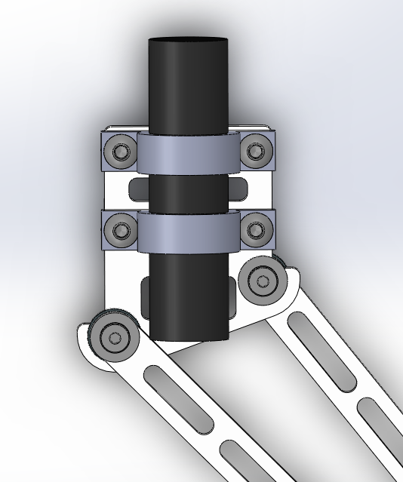
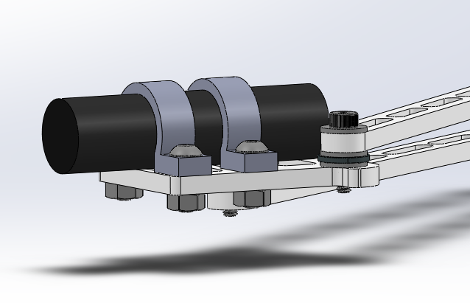
Flashlight-to-coupler mounting Strategy
!! Using 3D printing Material for lighter weight and better mounting
Arch links force the flashlight
face the photosensors
Top two arch links are tightened with screws to prevent the flashlight from sliding back and forth
Follower is below the coupler while input is above the coupler
Notes:
**The stands of the leftmost and rightmost photosensor are printed with a cone around the light receptor

Slide 7
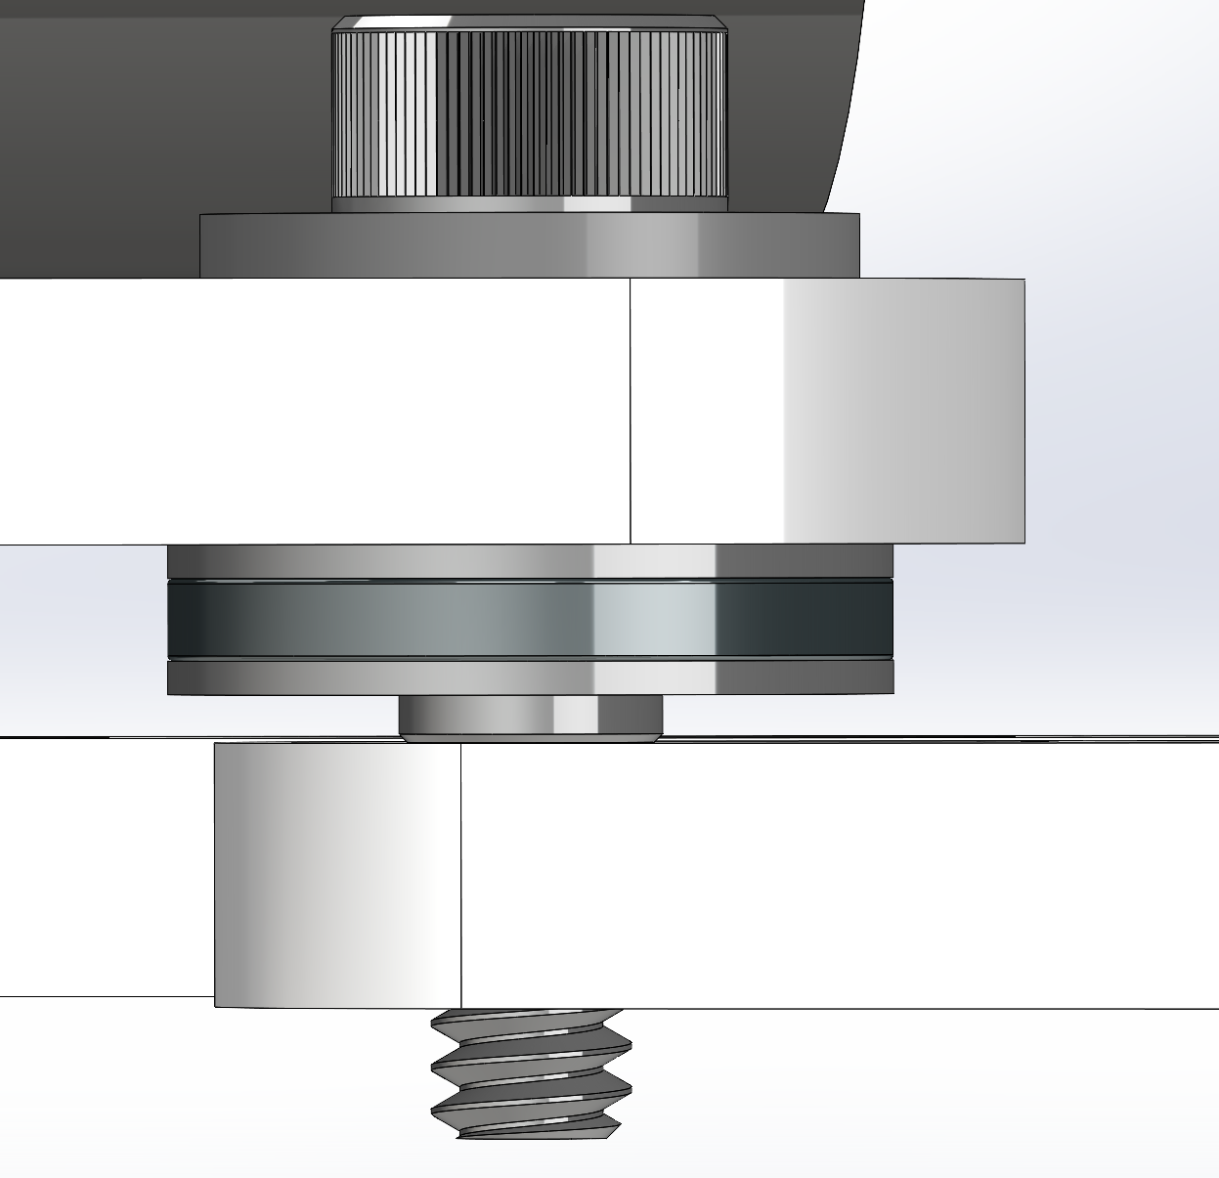
Joint design
Screw
Washer
Link 1
Needle Thrust Bearing
Link 2

Slide 8
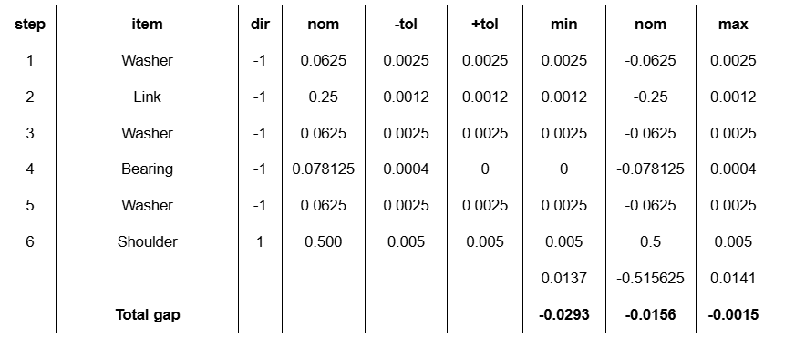
Joint design #1

Slide 9
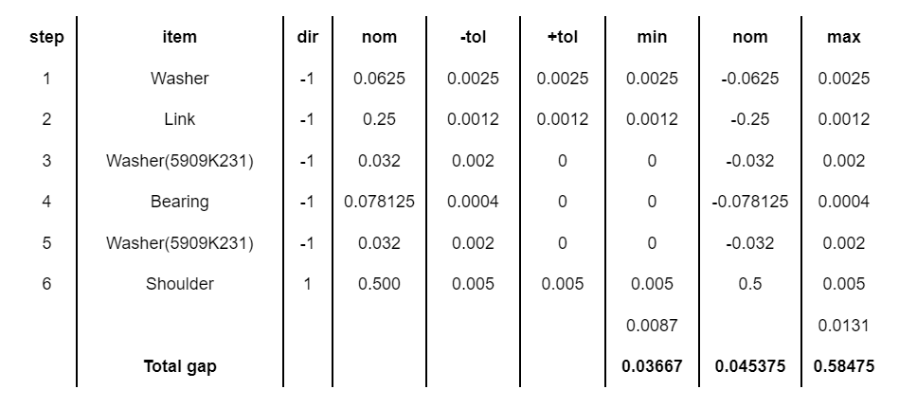
Joint design #2

Slide 10
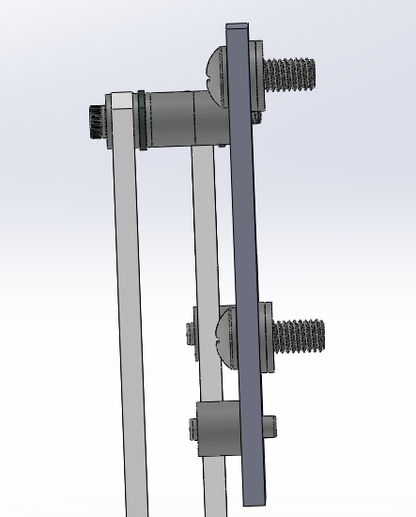
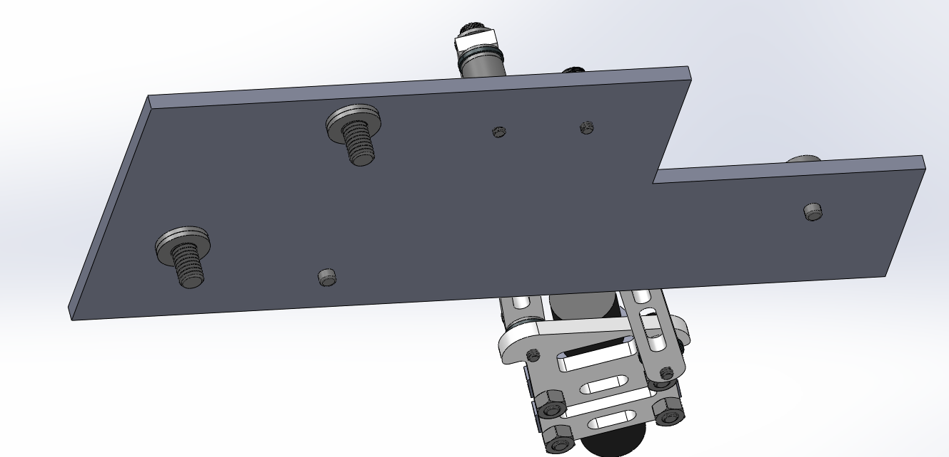
Playing Field Design
Side View
Baseplate & Playing Field
Use two screws to fix the baseplate with the playing field
Use washers for more accurate ray of light
Notes:
**The stands of the leftmost and rightmost photosensor are printed with a cone around the light receptor

Slide 11
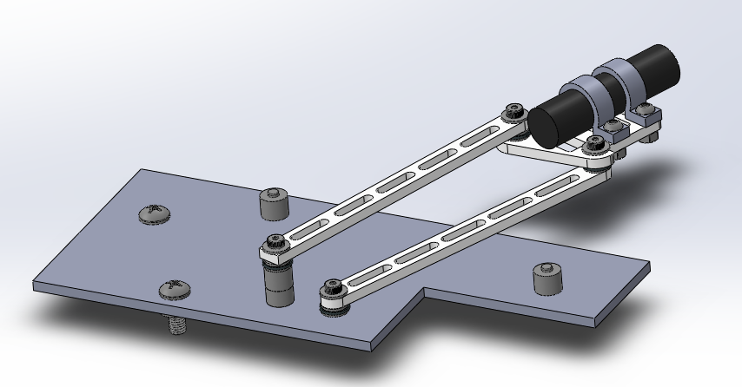
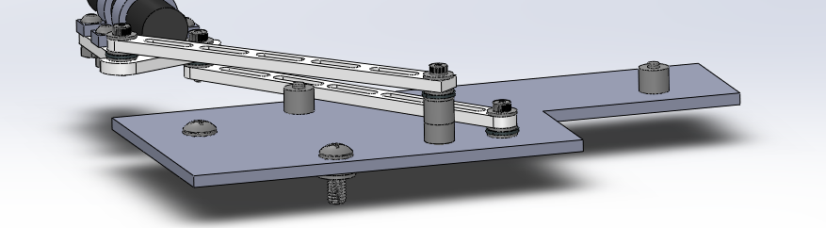
Playing Field Design
Hard stop & Baseplate
Limit of the rightmost position
Limit of the leftmost position
Use thick spacer as hard stops to limit the movement
of follower
Use screws to cross the center of the hard stops to fix
Notes:
**The stands of the leftmost and rightmost photosensor are printed with a cone around the light receptor

Slide 12
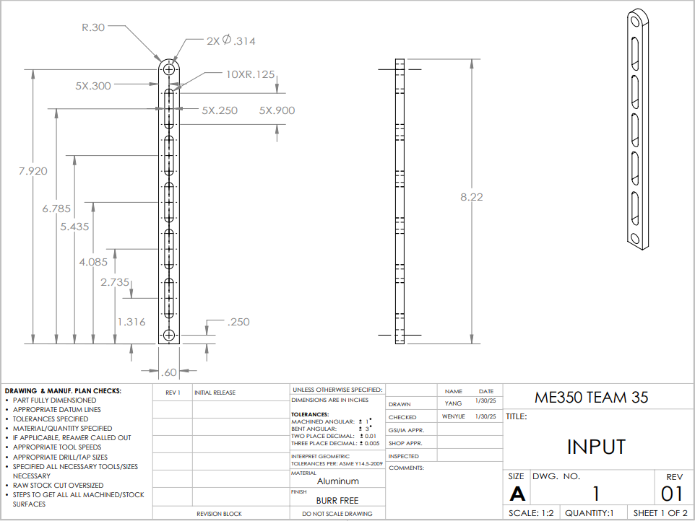
Engineering Drawings
Notes:
**The stands of the leftmost and rightmost photosensor are printed with a cone around the light receptor

Slide 13
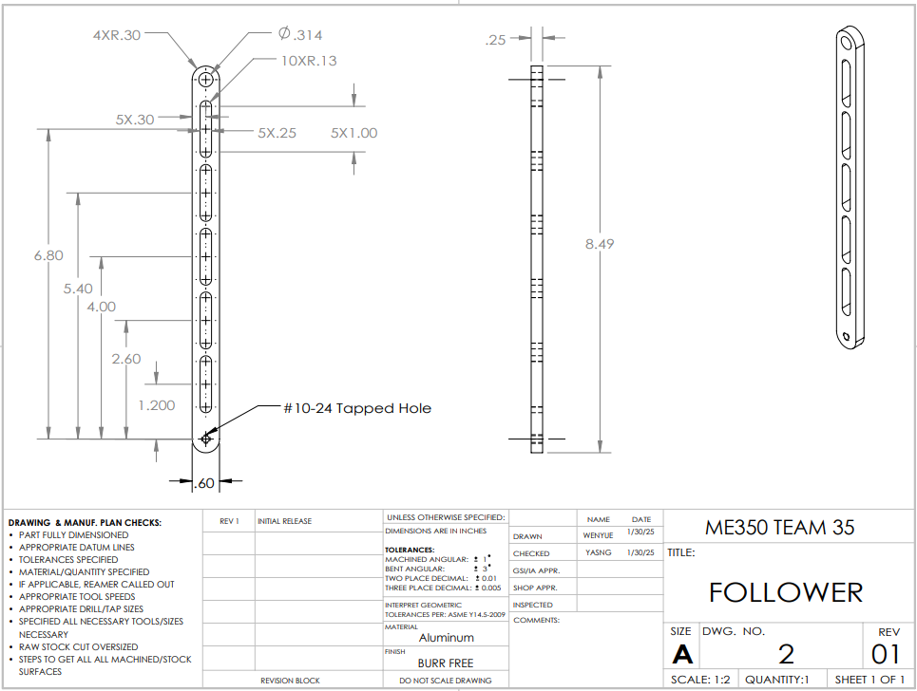
Engineering Drawings
Notes:
**The stands of the leftmost and rightmost photosensor are printed with a cone around the light receptor

Slide 14
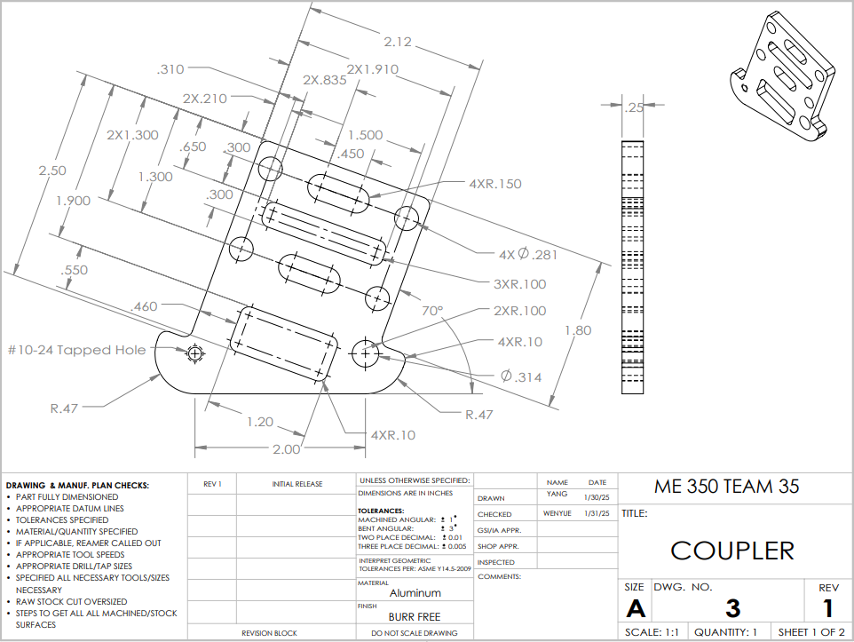
Engineering Drawings
Notes:
**The stands of the leftmost and rightmost photosensor are printed with a cone around the light receptor

Slide 15
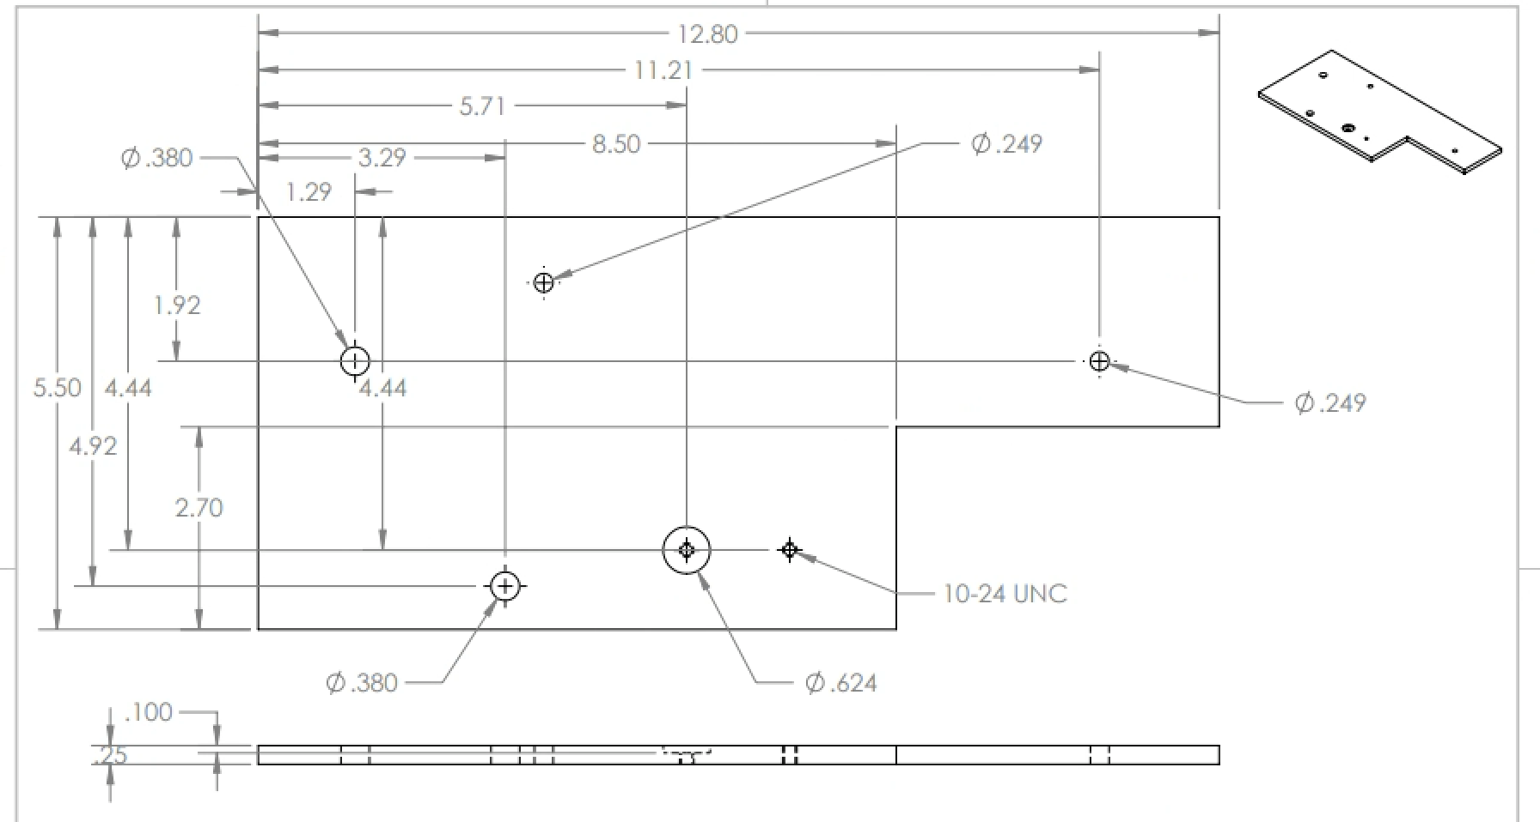
Engineering Drawings
Notes:
**The stands of the leftmost and rightmost photosensor are printed with a cone around the light receptor

Slide 16
Thanks
Q&A

